Slide 1
Overview
Movies offer the best form of entertainment among very many age sets.
The film industry has a very big market which generates profits in billions of money. I however requires a correct method to venture into this new goal.
The objectives that we set have all been achieved through plots of various horizontal bar graphs offering good visuals of the outlined objectives.

Slide 2
Business understanding
The film industry has a lot of profits with a very ready market but with that comes with observing the market shifts day in day out.
Microsoft venture into the movie industry will create a lot of profits to them and will make them a giant in almost all sectors. They have the financial muscle to produce high quality movies done by great film writers, producers and studios.

Slide 3
Problem statement
There are a lot of factors to consider before pumping any money into any industry. It is always wise and necessary to investigate and look at any available data found to check for any insights.
For Microsoft to be successful and generate more revenue in the film industry, we have to dig deeper into data and have a look at what factors make a great movies.

Slide 4
Objectives
The task assigned was to look into the movie data and derive insights from the this industry and make recommendations to Microsoft.
The most important fields which appeared to be of consideration were:
1.Movie average ratings.
2. The popular genres.
3. The studios production costs and profits.
4. The directors and writers experience.
5. Ratings in terms of age.

Slide 5
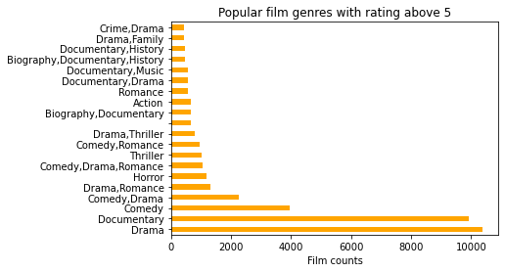
Analysis
Visuals often communicate more than just words. For every objective given, plots were made in relation to the task.
The plot shows the movie genres which have the rating above 5. Drama movies and documentaries have the highest ratings as well as seem to be popular.

Slide 6
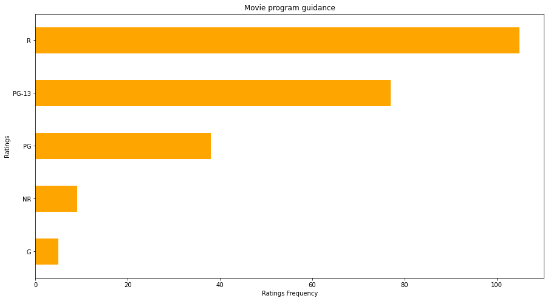
This plot helps us visualize the movie ratings frequencies. It shows which ratings are popular in the movie audience and are bound to produce more revenues.
The R rating signifies rating below 17 years of age.
Most films have a good audience among people between 13 and 17 years.
NR rating signifies not rated.
G is a rating for general audience.

Slide 7
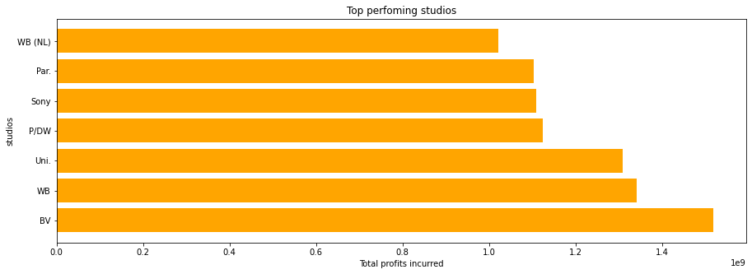
The plot seeks to address the objective of knowing which studios are currently operating on a good profit margin.
A good profit margin easily translates enough revenue from films produced and therefore the ones with high profits are the best ones to approach.

Slide 8
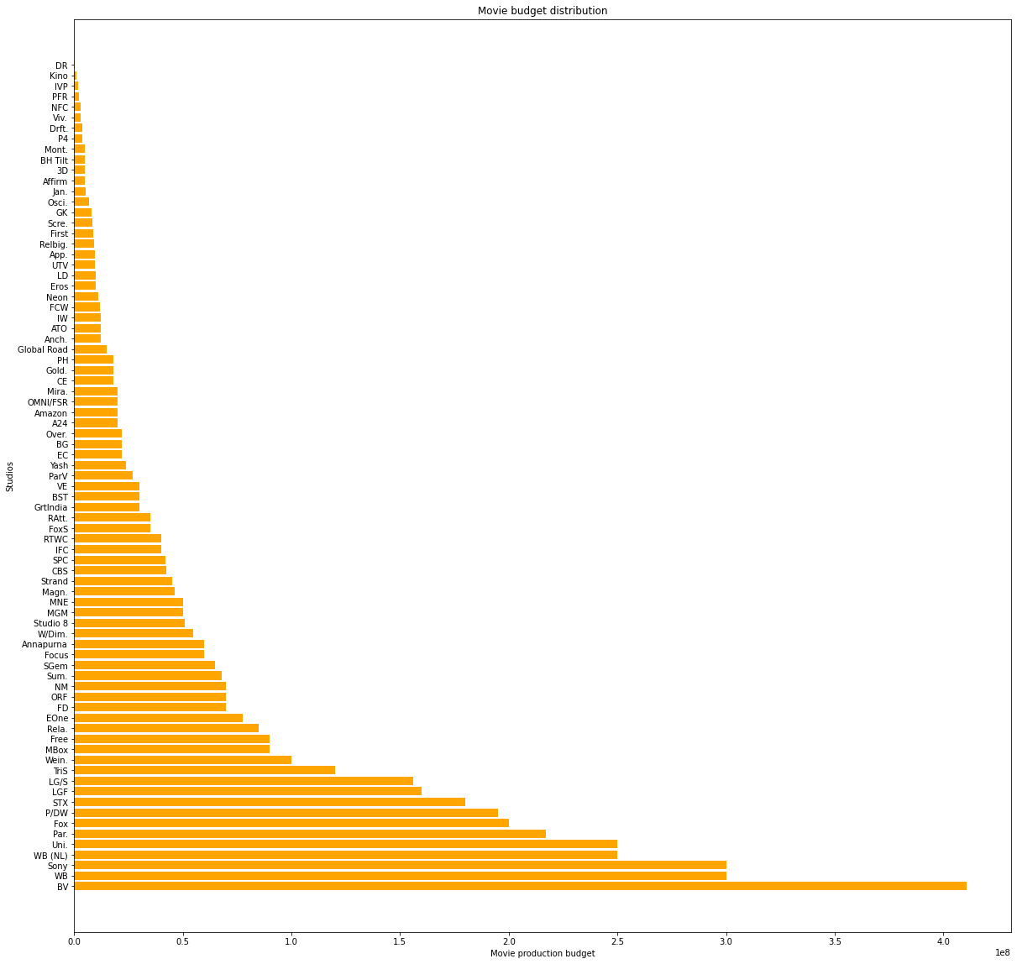
This plot seeks to address the objective of production budgets of various studios.
It sorts them in a descending fashion. Sony and WB studios have the highest budgets to shoot films.

Slide 9
Recommendations
The plots have provided us with a basis for providing reccommendatios to Microsoft. They include:
Invest in drama , documentaries or comedy genres.
Sony, BV and WB studios are the best studios because they have the best operating profits and are also easily available.
Most ratings are for people below age 17 and so content should not be explicit.
Clint Eastwood is the best manager and Mike white and Peter Morgan the best writers to approach for a film project.

